Slide 1
Probabilistic Robotics
Bayes Filter Implementations
Particle filters
HW 7:
Looking for figure 1: image/diagram
Review presentation details
Example of particle filter
Course evaluation

Slide 2
HW 7
Problem: What is the problem you would like to solve? What are the uncertainties in this problem? What is the general approach you plan to take? What audience is interested in the solution to this problem?
Background: What work has already been done on this problem? What alternative approaches have already been tried? Why has the problem not already been solved?
Methods: What is your special approach that will help you solve this problem where others have failed previously? Provide simulation results. What tools exist that will help you solve it? What intermediate results will there be, on the way to the final solution? How will you evaluate your intermediate and final results?
Research Plan: Provide a plan for carrying out your research project, including estimates of how long each stage will take, how you will respond to the results of intermediate evaluations, and when the project will be completed. List the conferences and journals where you would submit papers on your results.

Slide 3
Slides
title slide: name, figure, email,
Slide numbers/total number of slides
Minimize space consumed by logos/etc. Readability is key
Use color (images, plots, etc.)
Enlarge fonts and graphics to occupy the entire slide
Limit detail (don’t exhaust us) that’s what paper is for!
End with summary slide
  summarizes contribution in ~3 bullets
  OK to be ‘beneficial marketing’ style, stating why work/result is so great
Notes:
Otherwise the audience is left in front of a blank “Thank-you / Questions?” slide without having your concluding bullets or any technical content in front of them to ponder.
----- Meeting Notes (4/20/15 13:25) -----
tufte website

Slide 4
Questions?
Don’t do this
Notes:
This is a terrible slide

Slide 5
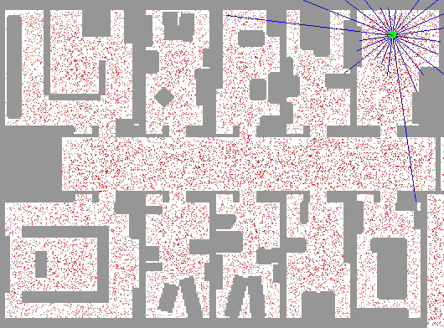
Sample-based Localization (sonar)

Slide 6
Particle Filters
Represent belief by random samples
Estimation of non-Gaussian, nonlinear processes
Monte Carlo filter, Survival of the fittest, Condensation, Bootstrap filter, Particle filter
Filtering: [Rubin, 88], [Gordon et al., 93], [Kitagawa 96]
Computer vision: [Isard and Blake 96, 98]
Dynamic Bayesian Networks: [Kanazawa et al., 95]d

Slide 7
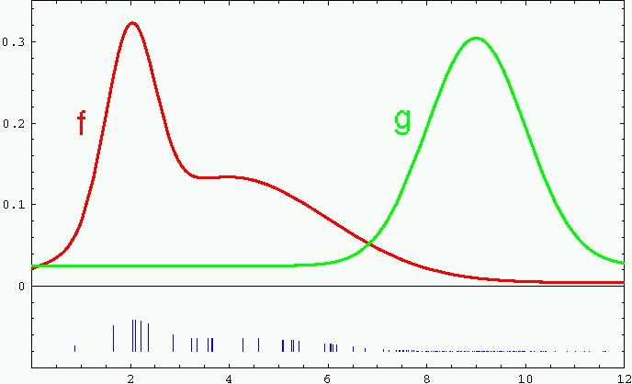
Importance Sampling
Weight samples: w = f / g

Slide 8
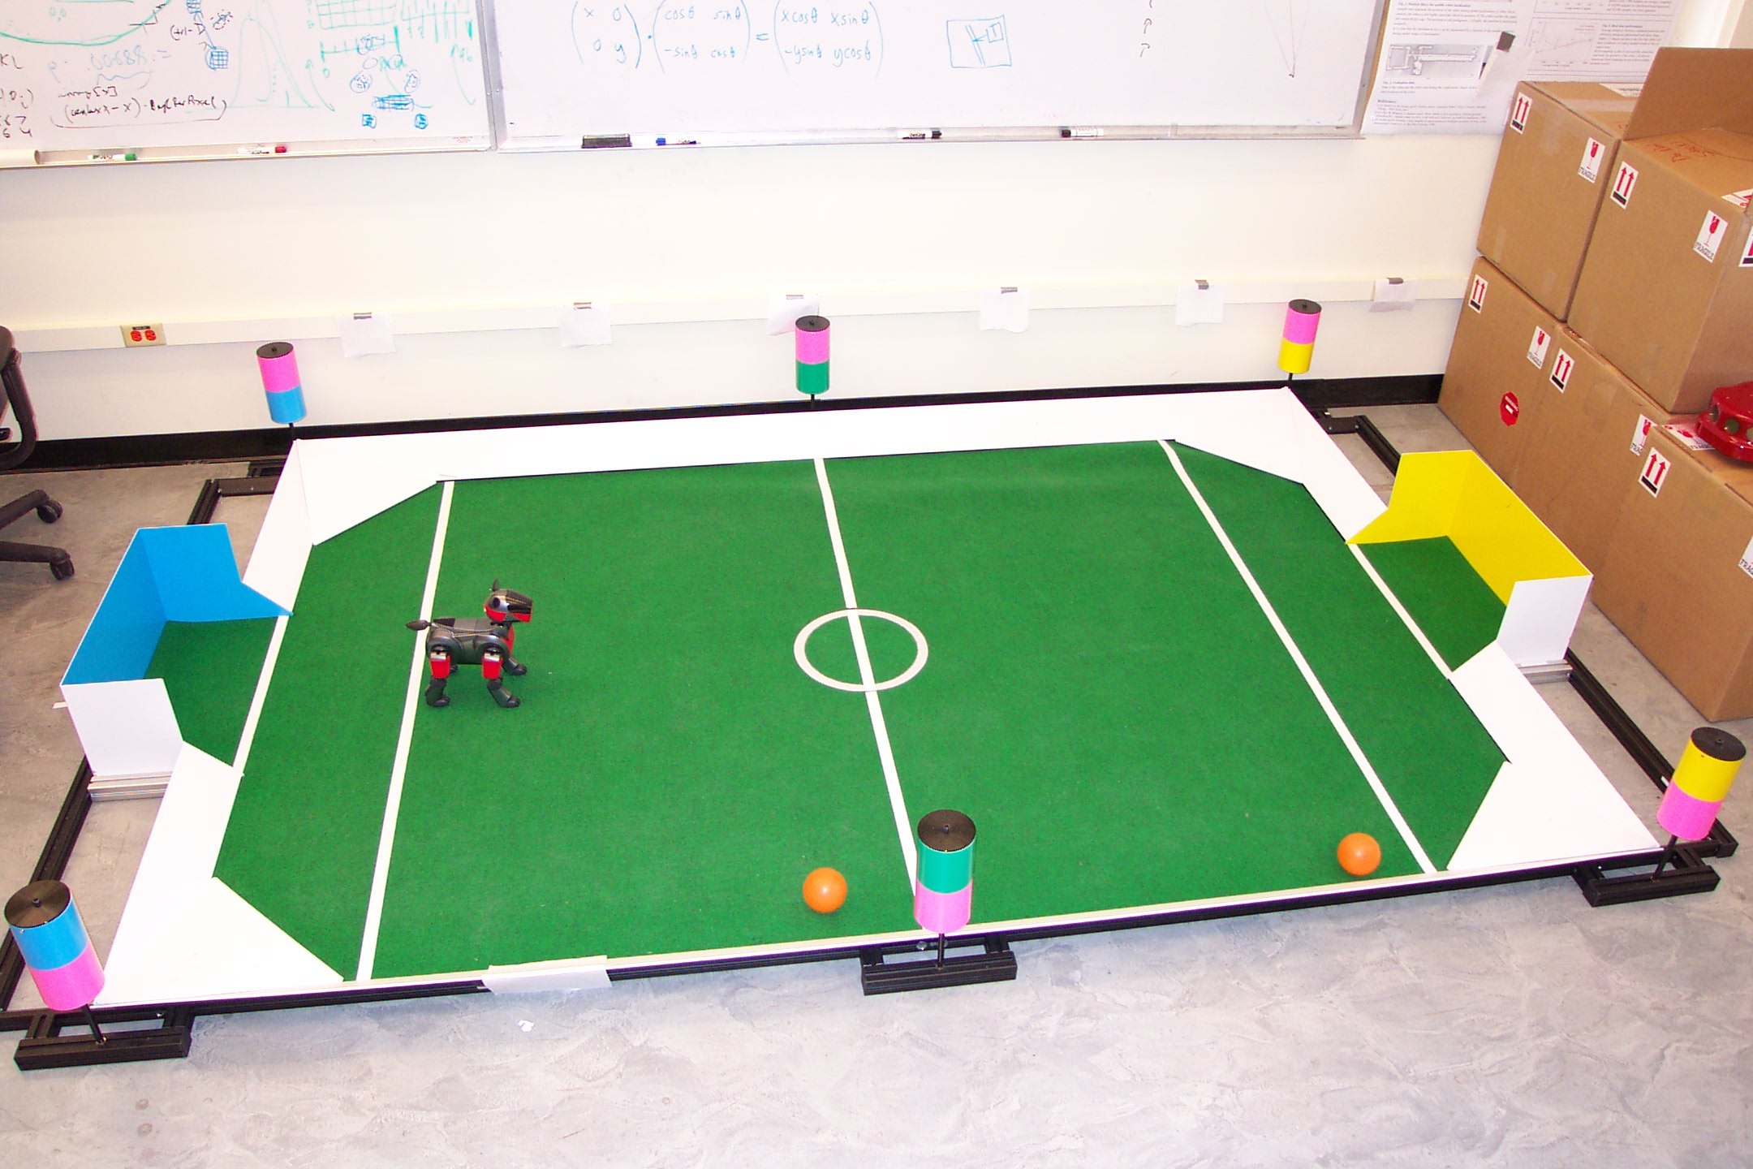
Importance Sampling with Resampling:
Landmark Detection Example

Slide 9
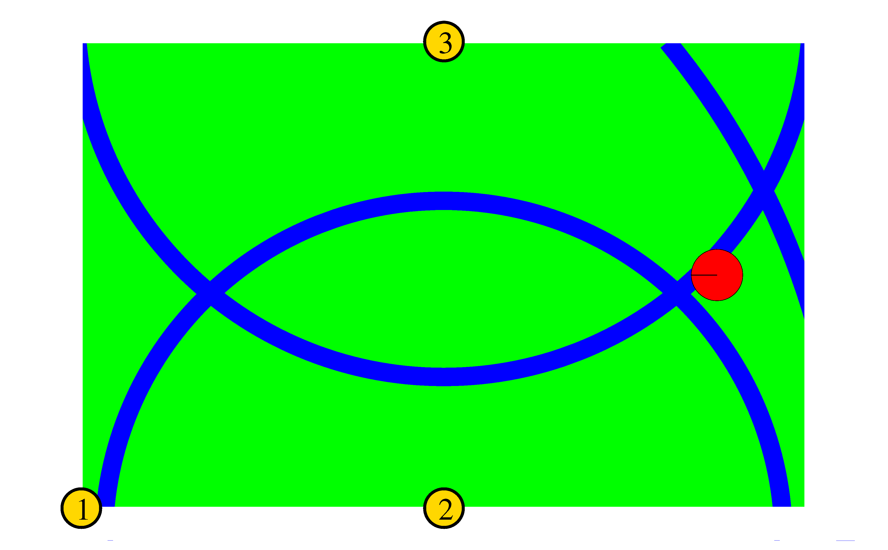


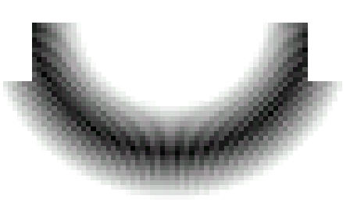
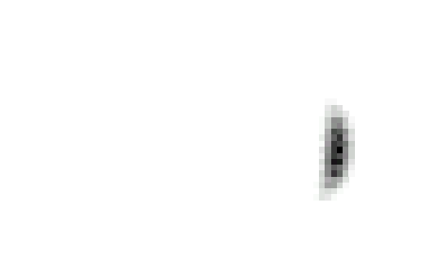
Distributions

Slide 10
Distributions
Wanted: samples distributed according to p(x| z₁, z₂, z₃)

Slide 11
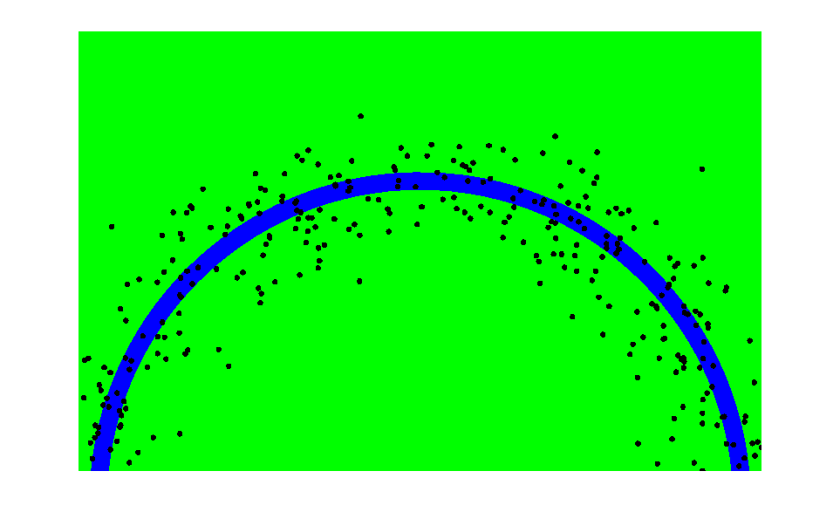
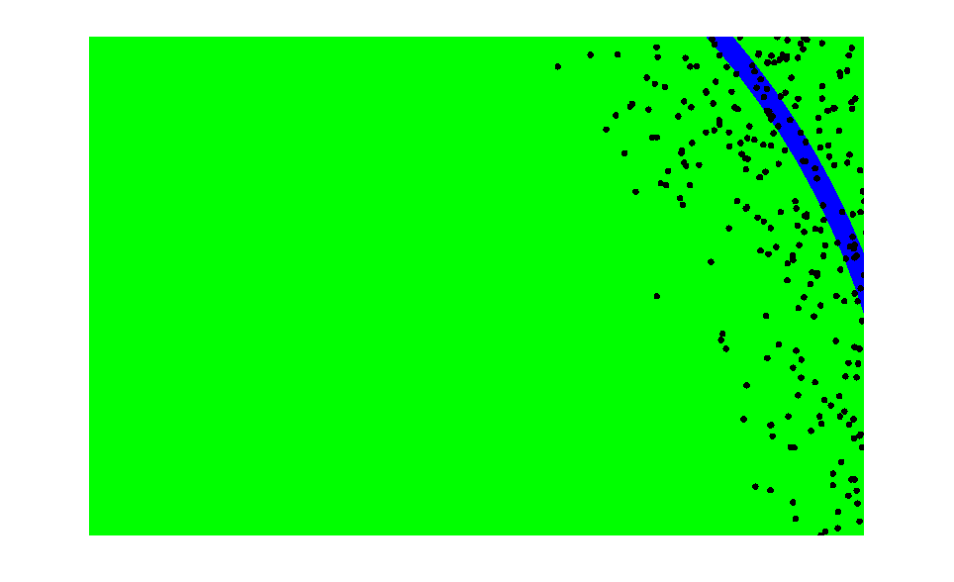
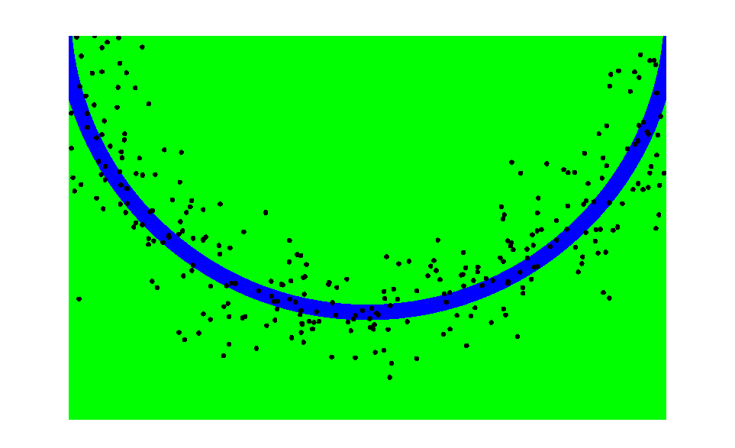
This is Easy!
We can draw samples from p(x|z_{l}) by adding noise to the detection parameters.

Slide 12
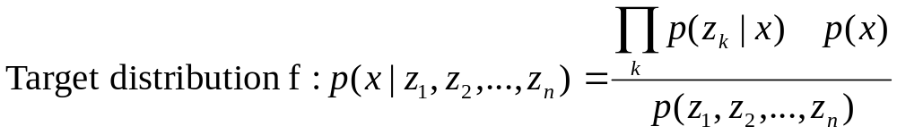
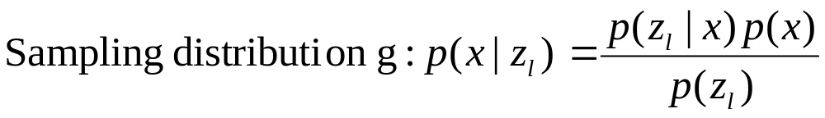
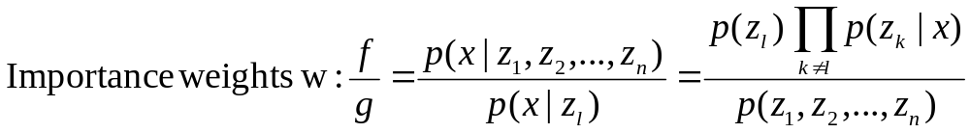
Importance Sampling with Resampling

Slide 13
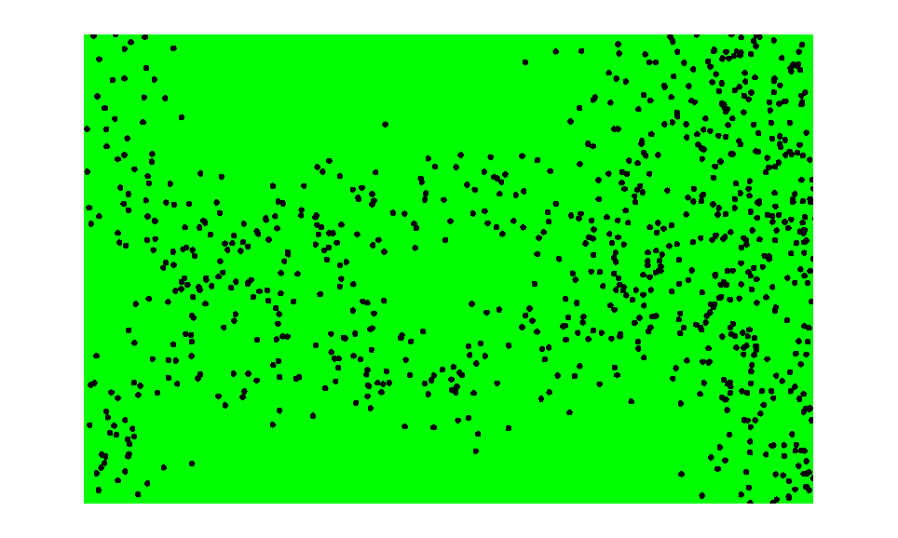
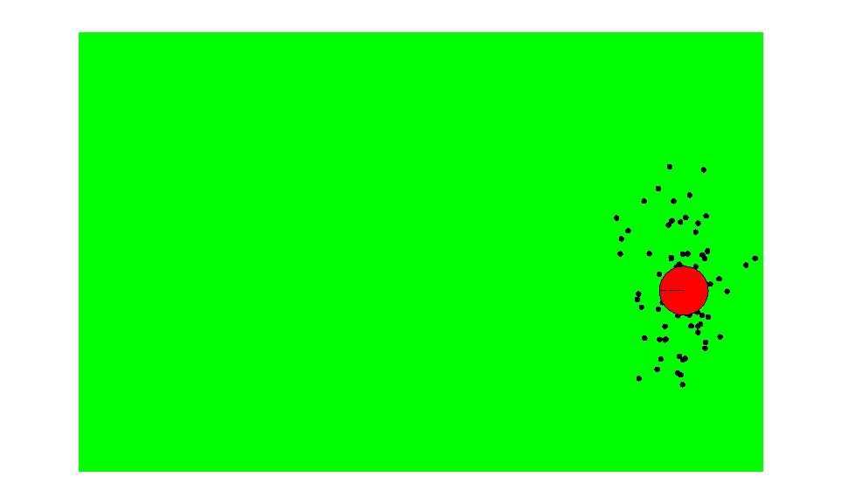
Importance Sampling with Resampling
Weighted samples
After resampling

Slide 14
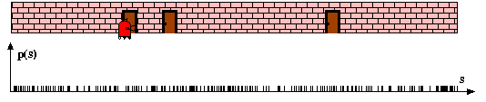
Particle Filters

Slide 15
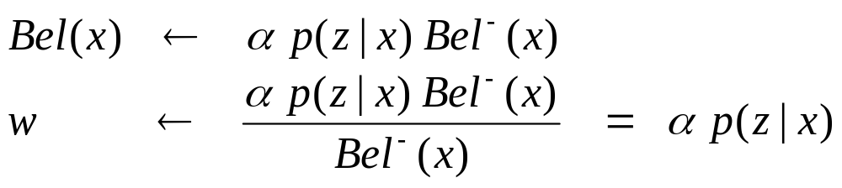
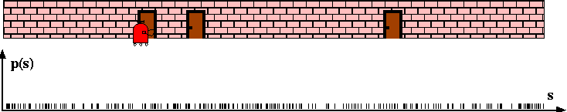
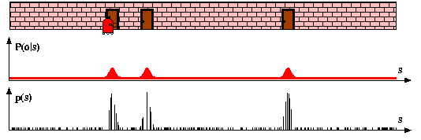
Sensor Information: Importance Sampling

Slide 16
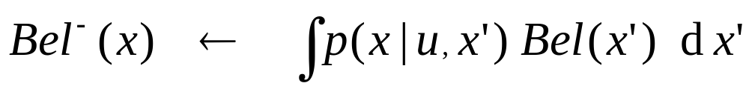
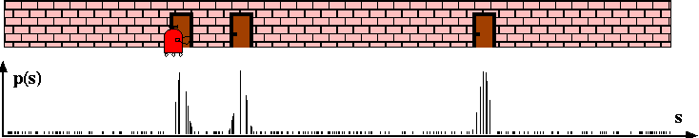
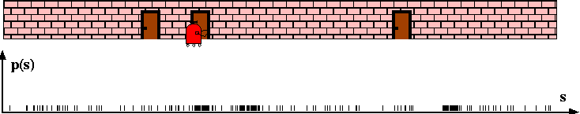
Robot Motion

Slide 17
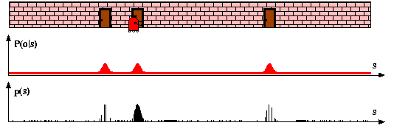
Sensor Information: Importance Sampling

Slide 18
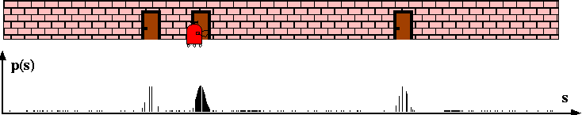
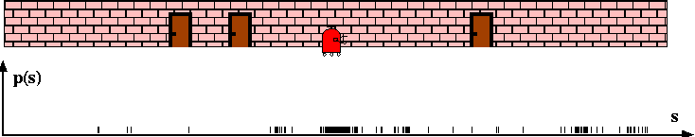
Robot Motion

Slide 19










Particle Filter Algorithm
Algorithm particle_filter( S_{t-1}, u_{t-1} z_{t}):
For Generate new samples
Sample index j(i) from the discrete distribution given by w_{t-1}
Sample from using and
Compute importance weight
Update normalization factor
Insert
For
Normalize weights

Slide 20
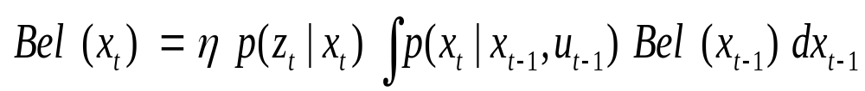
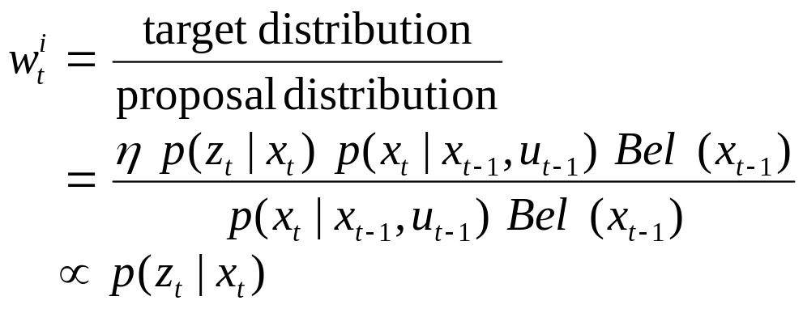
Particle Filter Algorithm
draw x^{i}_{t−1} from Bel(x_{t−1})
draw x^{i}_{t} from p(x_{t} | x^{i}_{t−1},u_{t−1})
Importance factor for x^{i}_{t}:

Slide 21
Resampling
Given: Set S of weighted samples.
Wanted : Random sample, where the probability of drawing x_{i} is given by w_{i}.
Typically done n times with replacement to generate new sample set S’.

Slide 22
Resampling
w_{n}
w₁
w_{n}
w₁
w₂
w₂
W_{n-1}
W_{n-1}
w₃
w₃
Stochastic universal sampling
Systematic resampling
Linear time complexity
Easy to implement, low variance
Roulette wheel
Binary search, n log n

Slide 23








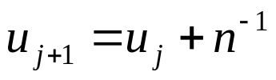
Resampling Algorithm
Algorithm systematic_resampling(S,n):
For Generate cdf
Initialize threshold
For Draw samples …
While ( ) Skip until next threshold reached
Insert
Increment threshold
Return S’
Also called stochastic universal sampling

Slide 24
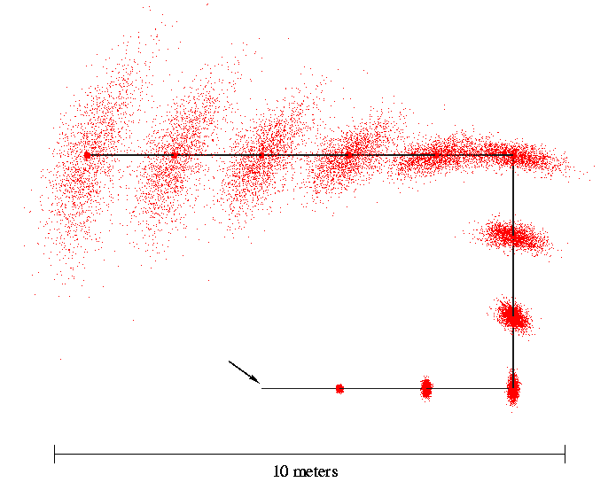
Motion Model Reminder
Start

Slide 25
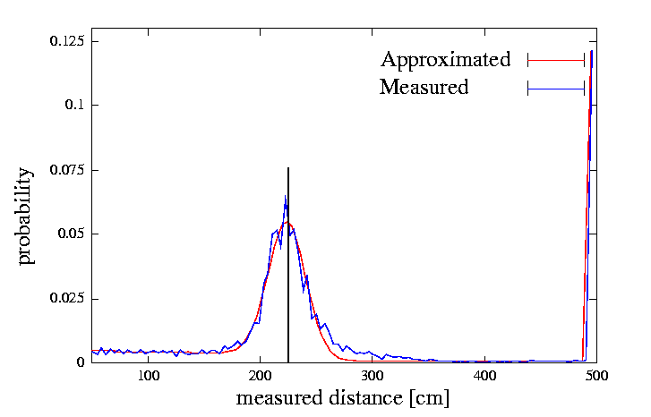
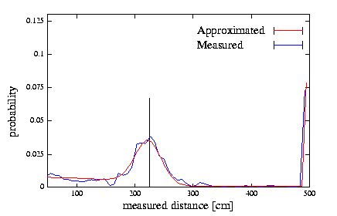
Proximity Sensor Model Reminder
Laser sensor
Sonar sensor

Slide 26


Slide 27
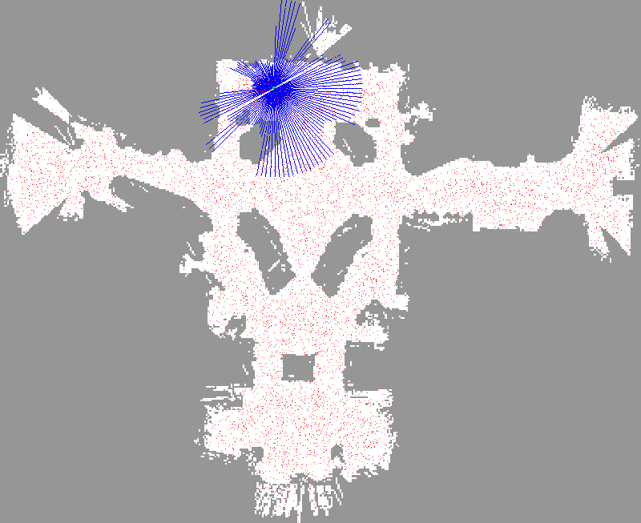

Slide 28


Slide 29


Slide 30
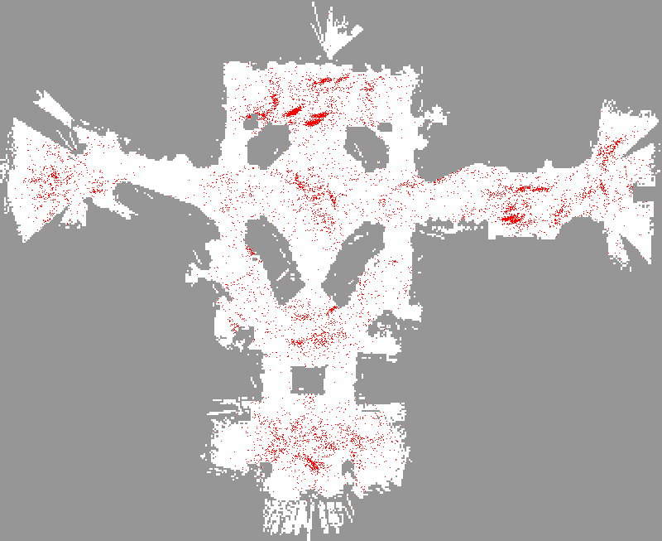

Slide 31
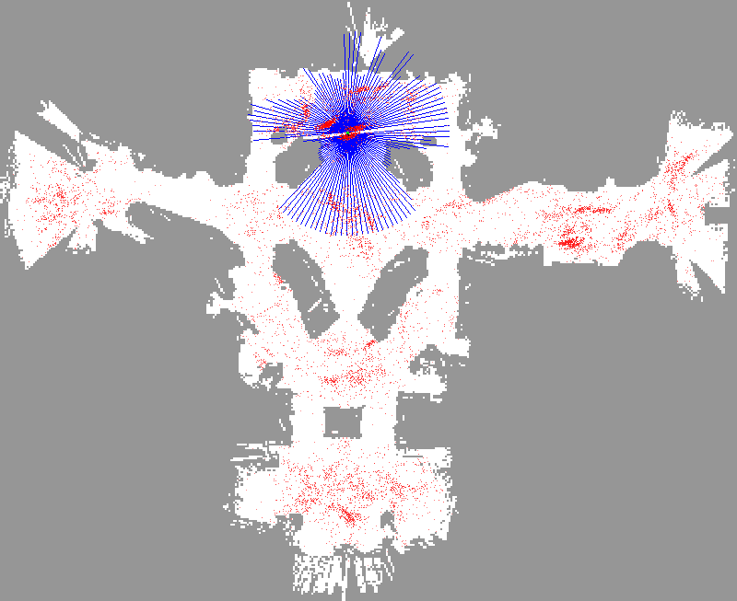

Slide 32
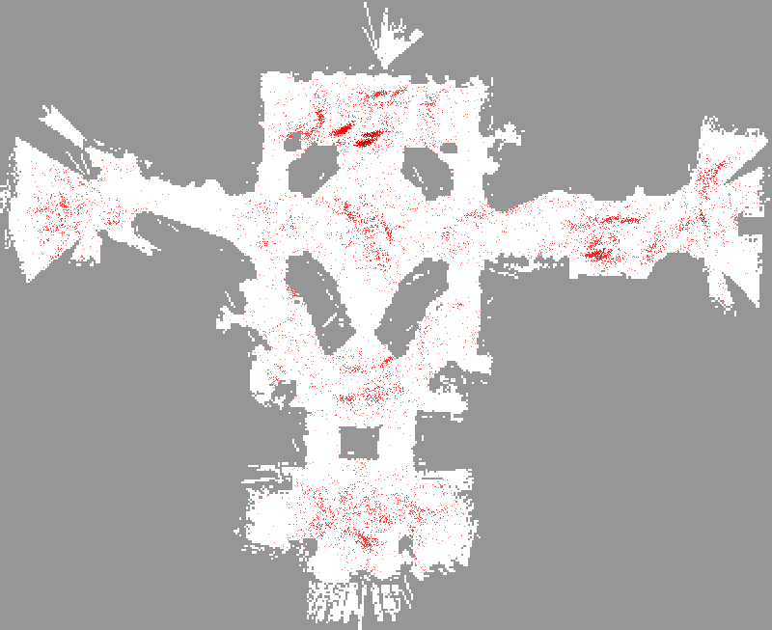

Slide 33
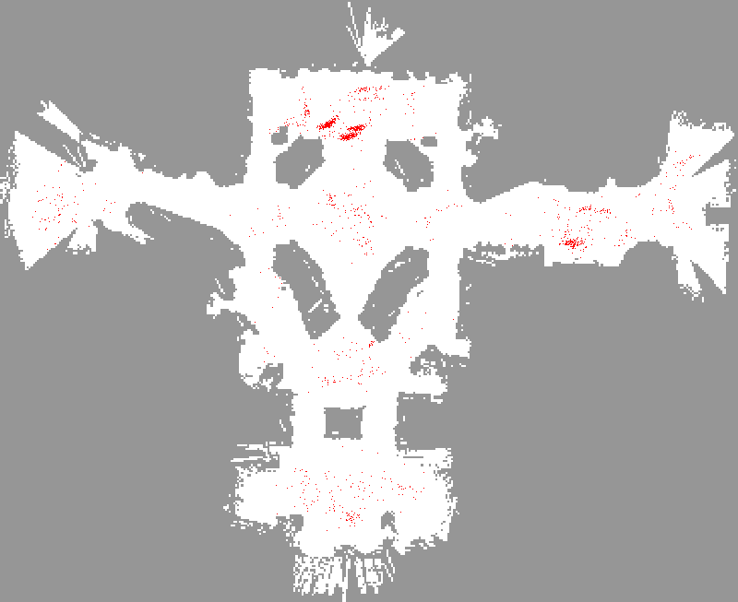

Slide 34
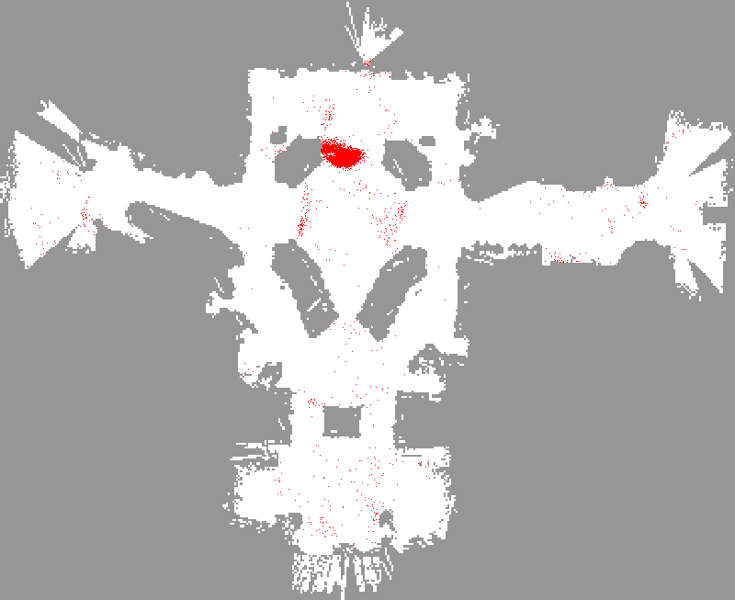

Slide 35
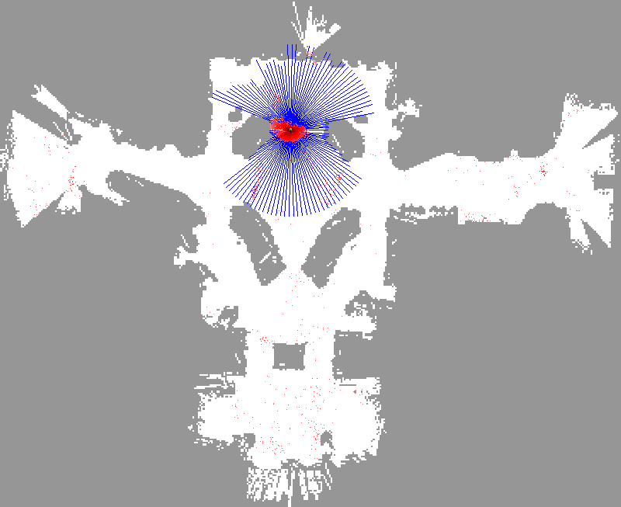

Slide 36


Slide 37


Slide 38


Slide 39
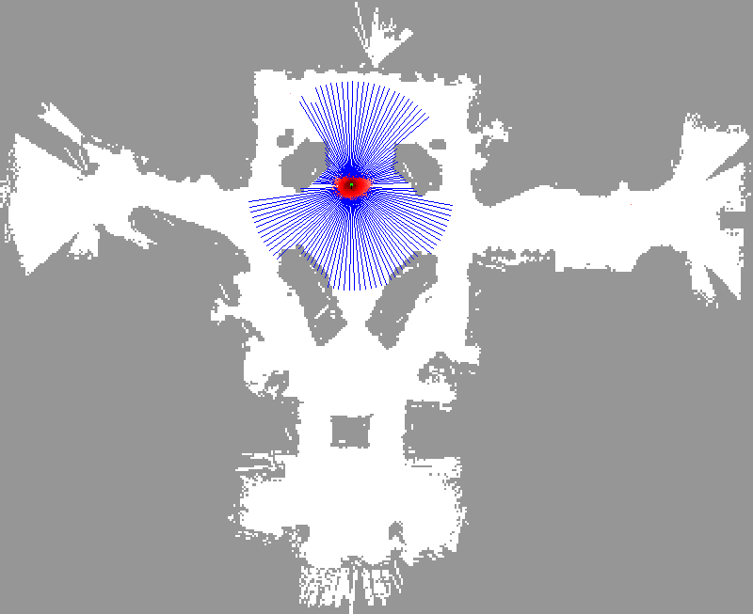

Slide 40
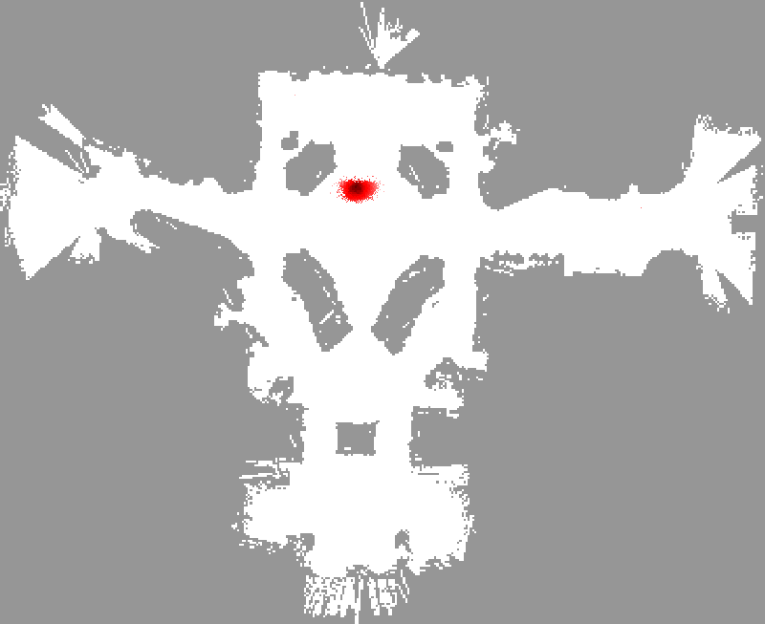

Slide 41
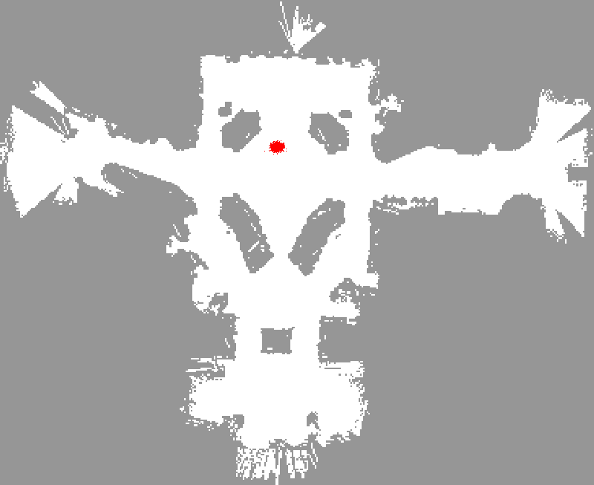

Slide 42


Slide 43
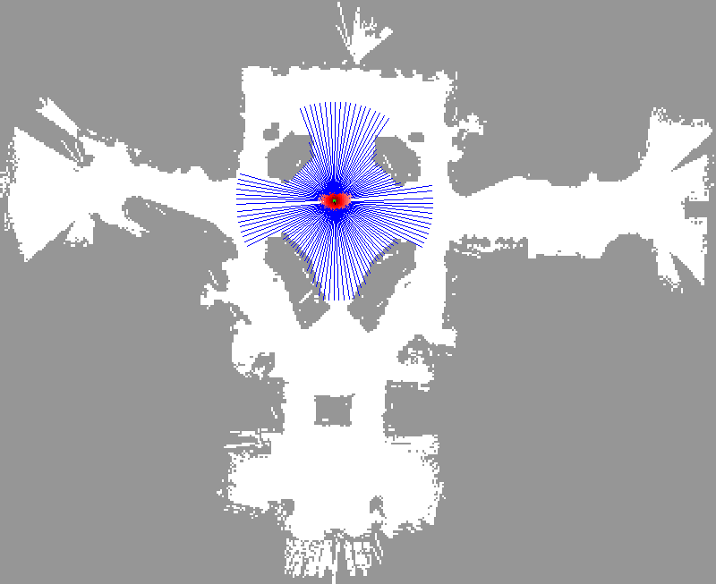

Slide 45
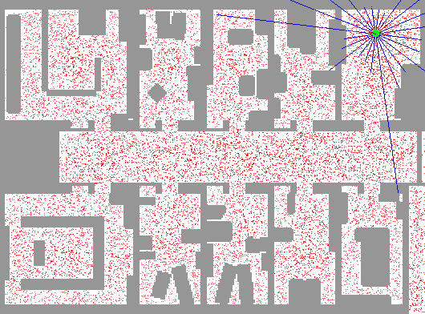
Sample-based Localization (sonar)

Slide 46
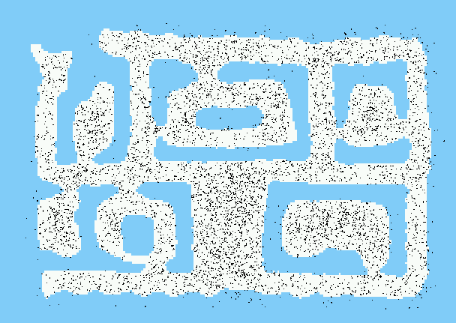
Initial Distribution

Slide 47

After Incorporating Ten Ultrasound Scans

Slide 48

After Incorporating 65 Ultrasound Scans

Slide 49

Estimated Path

Slide 50
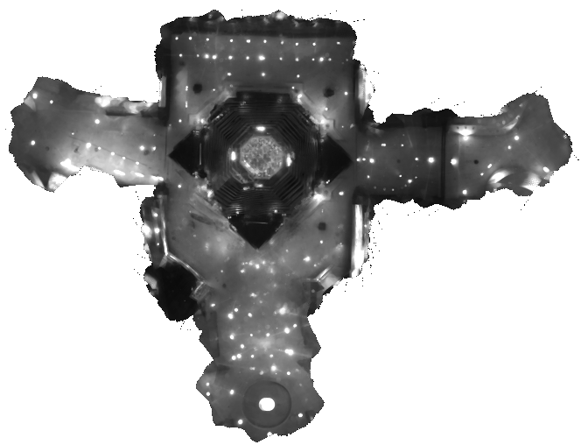
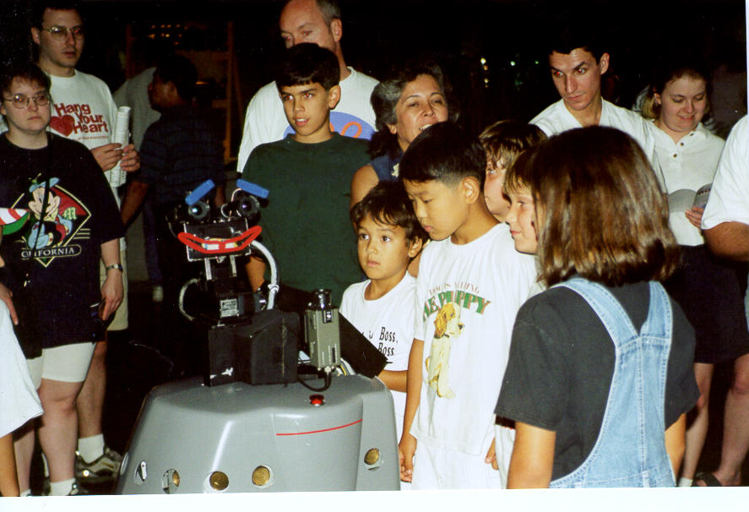
Using Ceiling Maps for Localization

Slide 51
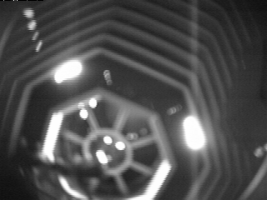
Vision-based Localization
P(z|x)
z
h(x)

Slide 52

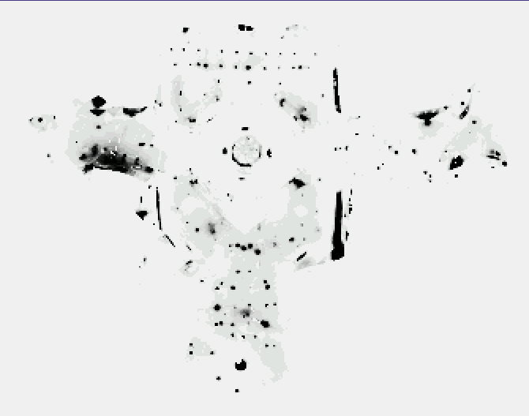
Under a Light
Measurement z:
P(z|x):

Slide 53

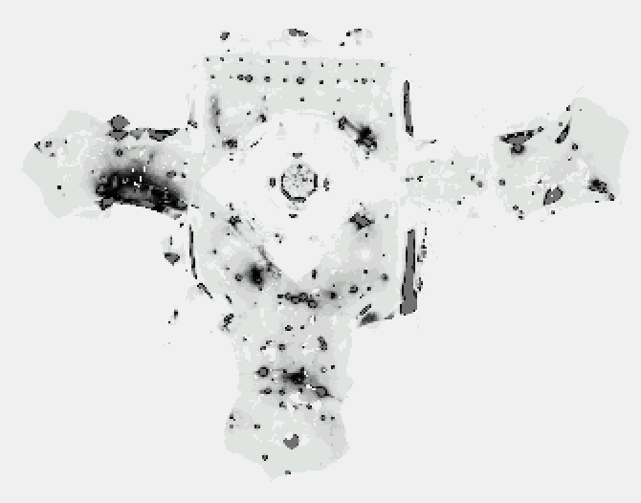
Next to a Light
Measurement z:
P(z|x):

Slide 54

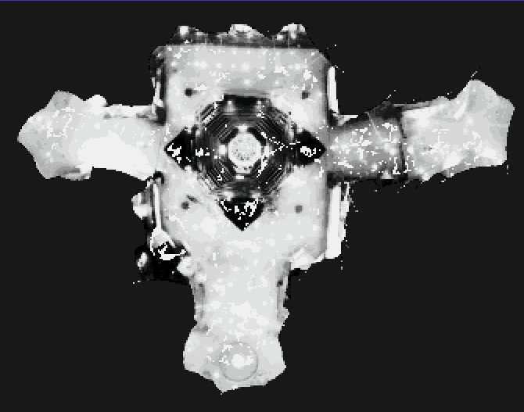
Elsewhere
Measurement z:
P(z|x):

Slide 55
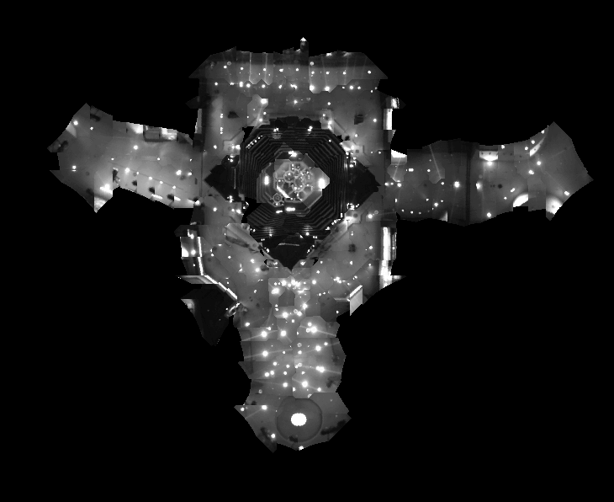
Global Localization Using Vision

Slide 56

Robots in Action: Albert

Slide 57


Application: Rhino and Albert Synchronized in Munich and Bonn
[Robotics And Automation Magazine, to appear]

Slide 58

Localization for AIBO robots

Slide 59
Limitations
The approach described so far is able to
  track the pose of a mobile robot and to
  globally localize the robot.
How can we deal with localization errors (i.e., the kidnapped robot problem)?

Slide 60
Approaches
Randomly insert samples (the robot can be teleported at any point in time).
Insert random samples proportional to the average likelihood of the particles (the robot has been teleported with higher probability when the likelihood of its observations drops).

Slide 61


Random Samples
Vision-Based Localization
936 Images, 4MB, .6secs/image
Trajectory of the robot:

Slide 62

Odometry Information

Slide 63

Image Sequence

Slide 64

Resulting Trajectories
Position tracking:

Slide 65

Resulting Trajectories
Global localization:

Slide 66

Global Localization

Slide 67

Kidnapping the Robot

Slide 68

Recovery from Failure

Slide 69
Summary
Particle filters are an implementation of recursive Bayesian filtering
They represent the posterior by a set of weighted samples.
In the context of localization, the particles are propagated according to the motion model.
They are then weighted according to the likelihood of the observations.
In a re-sampling step, new particles are drawn with a probability proportional to the likelihood of the observation.

